Slide 1
Chapter 13 – Graphical User Components Part 2
Outline
13.1 Introduction
13.2 JTextArea
13.3 Creating a Customized Subclass of JPanel
13.4 Creating a Self-Contained Subclass of JPanel
13.5 JSlider
13.6 Windows
13.7 Designing Programs that Execute as Applets or Applications
13.8 Using Menus with Frames
13.9 Using JPopupMenus
13.10 Pluggable Look-and-Feel
13.11 Using JDesktopPane and JInternalFrame
13.12 Layout Managers
13.13 BoxLayout Layout Manager
13.14 CardLayout Layout Manager
13.15 GridBagLayout Layout Manager
13.16 GridBagConstraints Constants RELATIVE and REMAINDER
13.17 (Optional Case Study) Thinking About Objects: Model-View- Controller

Slide 2
Chapter 13 – Graphical User Components Part 2
13.18 (Optional) Discovering Design Patterns: Design Patterns Used in Packages java.awt and javax.swing
13.18.1 Creational Design Patterns
13.18.2 Structural Design Patterns
13.18.3 Behavioral Design Patterns
13.18.4 Conclusion

Slide 3
13.1 Introduction
Advanced GUI components
  Text areas
  Sliders
  Menus
Advanced layout managers
  BoxLayout
  CardLayout
  GridBagLayout

Slide 4
13.2 JTextArea
JTextArea
  Area for manipulating multiple lines of text
  Inherits from JTextComponent

Slide 5
TextAreaDemo.java
Line 20
Lines 22-29
1 // Fig. 13.1: TextAreaDemo.java
2 // Copying selected text from one text area to another.
3
4 // Java core packages
5 import java.awt.*;
6 import java.awt.event.*;
7
8 // Java extension packages
9 import javax.swing.*;
10
11 public class TextAreaDemo extends JFrame {
12 private JTextArea textArea1, textArea2;
13 private JButton copyButton;
14
15 // set up GUI
16 public TextAreaDemo()
17 {
18 super( "TextArea Demo" );
19
20 Box box = Box.createHorizontalBox();
21
22 String string = "This is a demo string to\n" +
23 "illustrate copying text\n" +
24 "from one TextArea to \n" +
25 "another TextArea using an\n" + "external event\n";
26
27 // set up textArea1
28 textArea1 = new JTextArea( string, 10, 15 );
29 box.add( new JScrollPane( textArea1 ) );
30
31 // set up copyButton
32 copyButton = new JButton( "Copy >>>" );
33 copyButton.addActionListener(
34
Create Box container for organizing GUI components
Populate JTextArea with String, then add to Box

Slide 6
TextAreaDemo.java
Lines 40-43
Lines 52-53
35 // anonymous inner class to handle copyButton event
36 new ActionListener() {
37
38 // set text in textArea2 to selected
39 // text from textArea1
40 public void actionPerformed( ActionEvent event )
41 {
42 textArea2.setText( textArea1.getSelectedText() );
43 }
44
45 } // end anonymous inner class
46
47 ); // end call to addActionListener
48
49 box.add( copyButton );
50
51 // set up textArea2
52 textArea2 = new JTextArea( 10, 15 );
53 textArea2.setEditable( false );
54 box.add( new JScrollPane( textArea2 ) );
55
56 // add box to content pane
57 Container container = getContentPane();
58 container.add( box ); // place in BorderLayout.CENTER
59
60 setSize( 425, 200 );
61 setVisible( true );
62 }
63
64 // execute application
65 public static void main( String args[] )
66 {
67 TextAreaDemo application = new TextAreaDemo();
68
When user presses JButton, textArea1’s highlighted text is copied into textArea2
Instantiate uneditable JTextArea

Slide 7
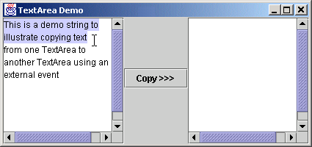
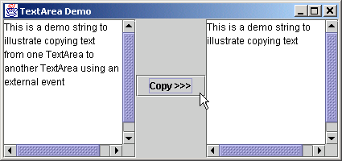
TextAreaDemo.java
Program Output
69 application.setDefaultCloseOperation(
70 JFrame.EXIT_ON_CLOSE );
71 }
72
73 } // end class TextAreaDemo

Slide 8
13.3 Creating a Customized Subclass of JPanel
Extend JPanel to create new components
  Dedicated drawing area
    Method paintComponent of class JComponent

Slide 9
CustomPanel.java
Lines 12
Lines 15-23
Line 29
1 // Fig. 13.2: CustomPanel.java
2 // A customized JPanel class.
3
4 // Java core packages
5 import java.awt.*;
6
7 // Java extension packages
8 import javax.swing.*;
9
10 public class CustomPanel extends JPanel {
11 public final static int CIRCLE = 1, SQUARE = 2;
12 private int shape;
13
14 // use shape to draw an oval or rectangle
15 public void paintComponent( Graphics g )
16 {
17 super.paintComponent( g );
18
19 if ( shape == CIRCLE )
20 g.fillOval( 50, 10, 60, 60 );
21 else if ( shape == SQUARE )
22 g.fillRect( 50, 10, 60, 60 );
23 }
24
25 // set shape value and repaint CustomPanel
26 public void draw( int shapeToDraw )
27 {
28 shape = shapeToDraw;
29 repaint();
30 }
31
32 } // end class CustomPanel
Store integer representing shape to draw
Override method paintComponent of class JComponent to draw oval or rectangle
Method repaint calls method paintComponent

Slide 10
CustomPanelTest.java
Lines 22-23
1 // Fig. 13.3: CustomPanelTest.java
2 // Using a customized Panel object.
3
4 // Java core packages
5 import java.awt.*;
6 import java.awt.event.*;
7
8 // Java extension packages
9 import javax.swing.*;
10
11 public class CustomPanelTest extends JFrame {
12 private JPanel buttonPanel;
13 private CustomPanel myPanel;
14 private JButton circleButton, squareButton;
15
16 // set up GUI
17 public CustomPanelTest()
18 {
19 super( "CustomPanel Test" );
20
21 // create custom drawing area
22 myPanel = new CustomPanel();
23 myPanel.setBackground( Color.green );
24
25 // set up squareButton
26 squareButton = new JButton( "Square" );
27 squareButton.addActionListener(
28
29 // anonymous inner class to handle squareButton events
30 new ActionListener() {
31
Instantiate CustomPanel object and set background to green

Slide 11
CustomPanelTest.java
Lines 33-36
Lines 49-52
Line 60
32 // draw a square
33 public void actionPerformed( ActionEvent event )
34 {
35 myPanel.draw( CustomPanel.SQUARE );
36 }
37
38 } // end anonymous inner class
39
40 ); // end call to addActionListener
41
42 circleButton = new JButton( "Circle" );
43 circleButton.addActionListener(
44
45 // anonymous inner class to handle circleButton events
46 new ActionListener() {
47
48 // draw a circle
49 public void actionPerformed( ActionEvent event )
50 {
51 myPanel.draw( CustomPanel.CIRCLE );
52 }
53
54 } // end anonymous inner class
55
56 ); // end call to addActionListener
57
58 // set up panel containing buttons
59 buttonPanel = new JPanel();
60 buttonPanel.setLayout( new GridLayout( 1, 2 ) );
61 buttonPanel.add( circleButton );
62 buttonPanel.add( squareButton );
63
When user presses squareButton, draw square on CustomPanel
When user presses circleButton, draw circle on CustomPanel
Use GridLayout to organize buttons

Slide 12
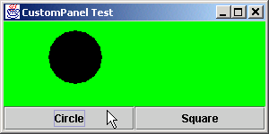
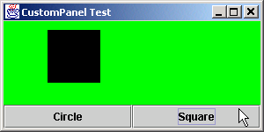
CustomPanelTest.java
Program Output
64 // attach button panel & custom drawing area to content pane
65 Container container = getContentPane();
66 container.add( myPanel, BorderLayout.CENTER );
67 container.add( buttonPanel, BorderLayout.SOUTH );
68
69 setSize( 300, 150 );
70 setVisible( true );
71 }
72
73 // execute application
74 public static void main( String args[] )
75 {
76 CustomPanelTest application = new CustomPanelTest();
77
78 application.setDefaultCloseOperation(
79 JFrame.EXIT_ON_CLOSE );
80 }
81
82 } // end class CustomPanelTest

Slide 13
13.4 Creating a Self-Contained Subclass of JPanel
JPanel
  Does not support conventional events
    e.g., events offered by buttons, text areas, etc.
  Capable of recognizing lower-level events
    e.g., mouse events, key events, etc.
  Self-contained panel
    Listens for its own mouse events

Slide 14
SelfContainedPanel.java
Line 20
Lines 29-30
1 // Fig. 13.4: SelfContainedPanel.java
2 // A self-contained JPanel class that
3 // handles its own mouse events.
4 package com.deitel.jhtp4.ch13;
5
6 // Java core packages
7 import java.awt.*;
8 import java.awt.event.*;
9
10 // Java extension packages
11 import javax.swing.*;
12
13 public class SelfContainedPanel extends JPanel {
14 private int x1, y1, x2, y2;
15
16 // set up mouse event handling for SelfContainedPanel
17 public SelfContainedPanel()
18 {
19 // set up mouse listener
20 addMouseListener(
21
22 // anonymous inner class for mouse pressed and
23 // released event handling
24 new MouseAdapter() {
25
26 // handle mouse press event
27 public void mousePressed( MouseEvent event )
28 {
29 x1 = event.getX();
30 y1 = event.getY();
31 }
32
Self-contained JPanel listens for MouseEvents
Save coordinates where user pressed mouse button

Slide 15
SelfContainedPanel.java
Lines 36-38
Line 46
Lines 54-56
33 // handle mouse release event
34 public void mouseReleased( MouseEvent event )
35 {
36 x2 = event.getX();
37 y2 = event.getY();
38 repaint();
39 }
40
41 } // end anonymous inner class
42
43 ); // end call to addMouseListener
44
45 // set up mouse motion listener
46 addMouseMotionListener(
47
48 // anonymous inner class to handle mouse drag events
49 new MouseMotionAdapter() {
50
51 // handle mouse drag event
52 public void mouseDragged( MouseEvent event )
53 {
54 x2 = event.getX();
55 y2 = event.getY();
56 repaint();
57 }
58
59 } // end anonymous inner class
60
61 ); // end call to addMouseMotionListener
62
63 } // end constructor
64
Save coordinates where user released mouse button, then repaint
Self-contained JPanel listens for when mouse moves
Save coordinates where user dragged mouse, then repaint

Slide 16
SelfContainedPanel.java
Lines 76-77
65 // return preferred width and height of SelfContainedPanel
66 public Dimension getPreferredSize()
67 {
68 return new Dimension( 150, 100 );
69 }
70
71 // paint an oval at the specified coordinates
72 public void paintComponent( Graphics g )
73 {
74 super.paintComponent( g );
75
76 g.drawOval( Math.min( x1, x2 ), Math.min( y1, y2 ),
77 Math.abs( x1 - x2 ), Math.abs( y1 - y2 ) );
78 }
79
80 } // end class SelfContainedPanel
Draw oval

Slide 17
SelfContainedPanelTest.java
Lines 24-25
Line 32
1 // Fig. 13.5: SelfContainedPanelTest.java
2 // Creating a self-contained subclass of JPanel
3 // that processes its own mouse events.
4
5 // Java core packages
6 import java.awt.*;
7 import java.awt.event.*;
8
9 // Java extension packages
10 import javax.swing.*;
11
12 // Deitel packages
13 import com.deitel.jhtp4.ch13.SelfContainedPanel;
14
15 public class SelfContainedPanelTest extends JFrame {
16 private SelfContainedPanel myPanel;
17
18
19 // set up GUI and mouse motion event handlers for
20 // application window
21 public SelfContainedPanelTest()
22 {
23 // set up a SelfContainedPanel
24 myPanel = new SelfContainedPanel();
25 myPanel.setBackground( Color.yellow );
26
27 Container container = getContentPane();
28 container.setLayout( new FlowLayout() );
29 container.add( myPanel );
30
31 // set up mouse motion event handling
32 addMouseMotionListener(
33
34 // anonymous inner class for mouse motion event handling
Instantiate SelfCustomPanel object and set background to yellow
Register anonymous-inner-class object to handle mouse motion events

Slide 18
SelfContainedPanelTest.java
Lines 38-49
35 new MouseMotionListener() {
36
37 // handle mouse drag event
38 public void mouseDragged( MouseEvent event )
39 {
40 setTitle( "Dragging: x=" + event.getX() +
41 "; y=" + event.getY() );
42 }
43
44 // handle mouse move event
45 public void mouseMoved( MouseEvent event )
46 {
47 setTitle( "Moving: x=" + event.getX() +
48 "; y=" + event.getY() );
49 }
50
51 } // end anonymous inner class
52
53 ); // end call to addMouseMotionListener
54
55 setSize( 300, 200 );
56 setVisible( true );
57 }
58
59 // execute application
60 public static void main( String args[] )
61 {
62 SelfContainedPanelTest application =
63 new SelfContainedPanelTest();
64
65 application.setDefaultCloseOperation(
66 JFrame.EXIT_ON_CLOSE );
67 }
68
69 } // end class SelfContainedPanelTest
Display String in title bar indicating x-y coordinate where mouse-motion event occurred

Slide 19
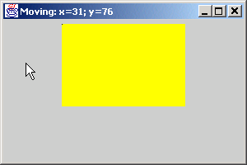
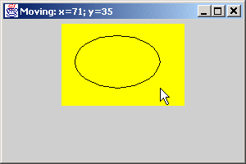
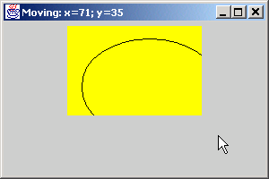
SelfContainedPanelTest.java
Program Output

Slide 20
13.5 JSlider
JSlider
  Enable users to select from range of integer values
  Several features
    Tick marks (major and minor)
    Snap-to ticks
    Orientation (horizontal and vertical)

Slide 21
Fig 13.6 Horizontal JSlider Component
Thumb
Tick Mark

Slide 22
OvalPanel.java
Line 18
Lines 22-28
1 // Fig. 13.7: OvalPanel.java
2 // A customized JPanel class.
3
4 // Java core packages
5 import java.awt.*;
6
7 // Java extension packages
8 import javax.swing.*;
9
10 public class OvalPanel extends JPanel {
11 private int diameter = 10;
12
13 // draw an oval of the specified diameter
14 public void paintComponent( Graphics g )
15 {
16 super.paintComponent( g );
17
18 g.fillOval( 10, 10, diameter, diameter );
19 }
20
21 // validate and set diameter, then repaint
22 public void setDiameter( int newDiameter )
23 {
24 // if diameter invalid, default to 10
25 diameter = ( newDiameter >= 0 ? newDiameter : 10 );
26
27 repaint();
28 }
29
30 // used by layout manager to determine preferred size
31 public Dimension getPreferredSize()
32 {
33 return new Dimension( 200, 200 );
34 }
35
Draw filled oval of diameter
Set diameter, then repaint

Slide 23
OvalPanel.java
36 // used by layout manager to determine minimum size
37 public Dimension getMinimumSize()
38 {
39 return getPreferredSize();
40 }
41
42 } // end class OvalPanel

Slide 24
SliderDemo.java
Lines 22-23
Lines 26-27
Line 32
1 // Fig. 13.8: SliderDemo.java
2 // Using JSliders to size an oval.
3
4 // Java core packages
5 import java.awt.*;
6 import java.awt.event.*;
7
8 // Java extension packages
9 import javax.swing.*;
10 import javax.swing.event.*;
11
12 public class SliderDemo extends JFrame {
13 private JSlider diameterSlider;
14 private OvalPanel myPanel;
15
16 // set up GUI
17 public SliderDemo()
18 {
19 super( "Slider Demo" );
20
21 // set up OvalPanel
22 myPanel = new OvalPanel();
23 myPanel.setBackground( Color.yellow );
24
25 // set up JSlider to control diameter value
26 diameterSlider =
27 new JSlider( SwingConstants.HORIZONTAL, 0, 200, 10 );
28 diameterSlider.setMajorTickSpacing( 10 );
29 diameterSlider.setPaintTicks( true );
30
31 // register JSlider event listener
32 diameterSlider.addChangeListener(
33
Instantiate OvalPanel object and set background to yellow
Instantiate horizontal JSlider object with min. value of 0, max. value of 200 and initial thumb location at 10
Register anonymous ChangeListener object to handle JSlider events

Slide 25
SliderDemo.java
Lines 38-41
35 new ChangeListener() {
36
37 // handle change in slider value
38 public void stateChanged( ChangeEvent e )
39 {
40 myPanel.setDiameter( diameterSlider.getValue() );
41 }
42
43 } // end anonymous inner class
44
45 ); // end call to addChangeListener
46
47 // attach components to content pane
48 Container container = getContentPane();
49 container.add( diameterSlider, BorderLayout.SOUTH );
50 container.add( myPanel, BorderLayout.CENTER );
51
52 setSize( 220, 270 );
53 setVisible( true );
54 }
55
56 // execute application
57 public static void main( String args[] )
58 {
59 SliderDemo application = new SliderDemo();
60
61 application.setDefaultCloseOperation(
62 JFrame.EXIT_ON_CLOSE );
63 }
64
65 } // end class SliderDemo
When user accesses JSlider, set OvalPanel’s diameter according to JSlider value

Slide 26
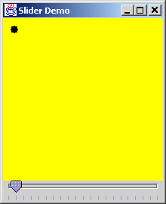
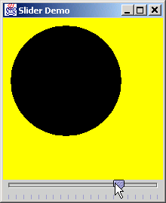
SliderDemo.java
Program Output

Slide 27
13.6 Windows
JFrame
  Windows with title bar and border
  Subclass of java.awt.Frame
    Subclass of java.awt.Window
  Heavyweight component
  Three operations when user closes window
    DISPOSE_ON_CLOSE
    DO_NOTHING_ON_CLOSE
    HIDE_ON_CLOSE

Slide 28
13.7 Designing Programs that Execute as Applets or Applications
Java programs
  Stand-alone applications
    JFrame
  Applets in Web browsers
  Convert applet to GUI-based application

Slide 29
DrawShapes.java
Line 11
1 // Fig. 13.9: DrawShapes.java
2 // Draw random lines, rectangles and ovals
3
4 // Java core packages
5 import java.awt.*;
6 import java.awt.event.*;
7
8 // Java extension packages
9 import javax.swing.*;
10
11 public class DrawShapes extends JApplet {
12 private JButton choices[];
13 private String names[] = { "Line", "Rectangle", "Oval" };
14 private JPanel buttonPanel;
15 private DrawPanel drawingPanel;
16 private int width = 300, height = 200;
17
18 // initialize applet; set up GUI
19 public void init()
20 {
21 // set up DrawPanel
22 drawingPanel = new DrawPanel( width, height );
23
24 // create array of buttons
25 choices = new JButton[ names.length ];
26
27 // set up panel for buttons
28 buttonPanel = new JPanel();
29 buttonPanel.setLayout(
30 new GridLayout( 1, choices.length ) );
31
32 // set up buttons and register their listeners
33 ButtonHandler handler = new ButtonHandler();
34
DrawShapes is an applet

Slide 30
DrawShapes.java
Line 60
Lines 62
Lines 65-68
35 for ( int count = 0; count < choices.length; count++ ) {
36 choices[ count ] = new JButton( names[ count ] );
37 buttonPanel.add( choices[ count ] );
38 choices[ count ].addActionListener( handler );
39 }
40
41 // attach components to content pane
42 Container container = getContentPane();
43 container.add( buttonPanel, BorderLayout.NORTH );
44 container.add( drawingPanel, BorderLayout.CENTER );
45 }
46
47 // enables application to specify width of drawing area
48 public void setWidth( int newWidth )
49 {
50 width = ( newWidth >= 0 ? newWidth : 300 );
51 }
52
53 // enables application to specify height of drawing area
54 public void setHeight( int newHeight )
55 {
56 height = ( newHeight >= 0 ? newHeight : 200 );
57 }
58
59 // execute applet as an application
60 public static void main( String args[] )
61 {
62 int width, height;
63
64 // check for command-line arguments
65 if ( args.length != 2 ) {
66 width = 300;
67 height = 200;
68 }
DrawShapes is stand-alone application as well
Specify application-window size
Determine initial application-window size

Slide 31
DrawShapes.java
Lines 69-72
Lines 75-76
Lines 78-79
Lines 82-88
69 else {
70 width = Integer.parseInt( args[ 0 ] );
71 height = Integer.parseInt( args[ 1 ] );
72 }
73
74 // create window in which applet will execute
75 JFrame applicationWindow =
76 new JFrame( "An applet running as an application" );
77
78 applicationWindow.setDefaultCloseOperation(
79 JFrame.EXIT_ON_CLOSE );
80
81 // create one applet instance
82 DrawShapes appletObject = new DrawShapes();
83 appletObject.setWidth( width );
84 appletObject.setHeight( height );
85
86 // call applet's init and start methods
87 appletObject.init();
88 appletObject.start();
89
90 // attach applet to center of window
91 applicationWindow.getContentPane().add( appletObject );
92
93 // set the window's size
94 applicationWindow.setSize( width, height );
95
96 // showing the window causes all GUI components
97 // attached to the window to be painted
98 applicationWindow.setVisible( true );
99 }
100
101 // private inner class to handle button events
102 private class ButtonHandler implements ActionListener {
103
Use command-line arguments to specify window width and height
Instantiate JFrame to run as stand-alone application
Allow for window termination
Instantiate and initialize applet if stand-alone application

Slide 32
DrawShapes.java
104 // determine button user pressed and set drawing area's
105 // current choice
106 public void actionPerformed( ActionEvent event )
107 {
108 for ( int count = 0; count < choices.length; count++ )
109
110 if ( event.getSource() == choices[ count ] ) {
111 drawingPanel.setCurrentChoice( count );
112 break;
113 }
114 }
115
116 } // end private inner class ButtonHandler
117
118 } // end class DrawShapes
119
120 // subclass of JPanel to allow drawing in a separate area
121 class DrawPanel extends JPanel {
122 private int currentChoice = -1; // don't draw first time
123 private int width = 100, height = 100;
124
125 // initialize width and height of DrawPanel
126 public DrawPanel( int newWidth, int newHeight )
127 {
128 width = ( newWidth >= 0 ? newWidth : 100 );
129 height = ( newHeight >= 0 ? newHeight : 100 );
130 }
131
132 // draw line, rectangle or oval based on user's choice
133 public void paintComponent( Graphics g )
134 {
135 super.paintComponent( g );
136

Slide 33
DrawShapes.java
136
137 switch( currentChoice ) {
138
139 case 0:
140 g.drawLine( randomX(), randomY(),
141 randomX(), randomY() );
142 break;
143
144 case 1:
145 g.drawRect( randomX(), randomY(),
146 randomX(), randomY() );
147 break;
148
149 case 2:
150 g.drawOval( randomX(), randomY(),
151 randomX(), randomY() );
152 break;
153 }
154
155 } // end method paintComponent
156
157 // specify current shape choice and repaint
158 public void setCurrentChoice( int choice )
159 {
160 currentChoice = choice;
161 repaint();
162 }
163
164 // pick random x coordinate
165 private int randomX()
166 {
167 return ( int ) ( Math.random() * width );
168 }
169

Slide 34
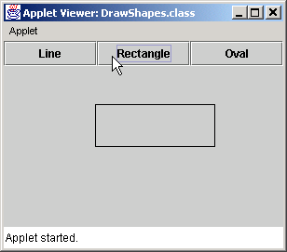
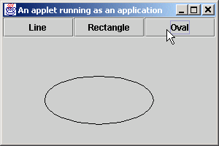
DrawShapes.java
Program Output
170 // pick random y coordinate
171 private int randomY()
172 {
173 return ( int ) ( Math.random() * height );
174 }
175
176 } // end class DrawPanel

Slide 35
13.8 Using Menus with Frames
Menus
  Allows for performing actions with cluttering GUI
  Contained by menu bar
    JMenuBar
  Comprised of menu items
    JMenuItem

Slide 36
MenuTest.java
Line 27
Line 31
1 // Fig. 13.10: MenuTest.java
2 // Demonstrating menus
3
4 // Java core packages
5 import java.awt.*;
6 import java.awt.event.*;
7
8 // Java extension packages
9 import javax.swing.*;
10
11 public class MenuTest extends JFrame {
12 private Color colorValues[] =
13 { Color.black, Color.blue, Color.red, Color.green };
14
15 private JRadioButtonMenuItem colorItems[], fonts[];
16 private JCheckBoxMenuItem styleItems[];
17 private JLabel displayLabel;
18 private ButtonGroup fontGroup, colorGroup;
19 private int style;
20
21 // set up GUI
22 public MenuTest()
23 {
24 super( "Using JMenus" );
25
26 // set up File menu and its menu items
27 JMenu fileMenu = new JMenu( "File" );
28 fileMenu.setMnemonic( 'F' );
29
30 // set up About... menu item
31 JMenuItem aboutItem = new JMenuItem( "About..." );
32 aboutItem.setMnemonic( 'A' );
33
34 aboutItem.addActionListener(
35
Instantiate File JMenu
Instantiate About… JMenuItem to be placed in fileMenu

Slide 37
MenuTest.java
Lines 40-45
Line 54
Lines 63-66
36 // anonymous inner class to handle menu item event
37 new ActionListener() {
38
39 // display message dialog when user selects About...
40 public void actionPerformed( ActionEvent event )
41 {
42 JOptionPane.showMessageDialog( MenuTest.this,
43 "This is an example\nof using menus",
44 "About", JOptionPane.PLAIN_MESSAGE );
45 }
46
47 } // end anonymous inner class
48
49 ); // end call to addActionListener
50
51 fileMenu.add( aboutItem );
52
53 // set up Exit menu item
54 JMenuItem exitItem = new JMenuItem( "Exit" );
55 exitItem.setMnemonic( 'x' );
56
57 exitItem.addActionListener(
58
59 // anonymous inner class to handle exitItem event
60 new ActionListener() {
61
62 // terminate application when user clicks exitItem
63 public void actionPerformed( ActionEvent event )
64 {
65 System.exit( 0 );
66 }
67
68 } // end anonymous inner class
69
70 ); // end call to addActionListener
When user selects About… JMenuItem, display message dialog with appropriate text
Instantiate Exit JMenuItem to be placed in fileMenu
When user selects Exit JMenuItem, exit system

Slide 38
MenuTest.java
Line 75
Line 80
Line 86
Lines 89-90
71
72 fileMenu.add( exitItem );
73
74 // create menu bar and attach it to MenuTest window
75 JMenuBar bar = new JMenuBar();
76 setJMenuBar( bar );
77 bar.add( fileMenu );
78
79 // create Format menu, its submenus and menu items
80 JMenu formatMenu = new JMenu( "Format" );
81 formatMenu.setMnemonic( 'r' );
82
83 // create Color submenu
84 String colors[] = { "Black", "Blue", "Red", "Green" };
85
86 JMenu colorMenu = new JMenu( "Color" );
87 colorMenu.setMnemonic( 'C' );
88
89 colorItems = new JRadioButtonMenuItem[ colors.length ];
90 colorGroup = new ButtonGroup();
91 ItemHandler itemHandler = new ItemHandler();
92
93 // create color radio button menu items
94 for ( int count = 0; count < colors.length; count++ ) {
95 colorItems[ count ] =
96 new JRadioButtonMenuItem( colors[ count ] );
97
98 colorMenu.add( colorItems[ count ] );
99 colorGroup.add( colorItems[ count ] );
100
101 colorItems[ count ].addActionListener( itemHandler );
102 }
103
104 // select first Color menu item
105 colorItems[ 0 ].setSelected( true );
Instantiate JMenuBar to contain JMenus
Instantiate Format JMenu
Instantiate Color JMenu (submenu of Format JMenu)
Instantiate JRadioButtonMenuItems for Color JMenu and ensure that only one menu item is selected at a time

Slide 39
MenuTest.java
Line 109
Line 114
Lines 117-118
106
107 // add format menu to menu bar
108 formatMenu.add( colorMenu );
109 formatMenu.addSeparator();
110
111 // create Font submenu
112 String fontNames[] = { "Serif", "Monospaced", "SansSerif" };
113
114 JMenu fontMenu = new JMenu( "Font" );
115 fontMenu.setMnemonic( 'n' );
116
117 fonts = new JRadioButtonMenuItem[ fontNames.length ];
118 fontGroup = new ButtonGroup();
119
120 // create Font radio button menu items
121 for ( int count = 0; count < fonts.length; count++ ) {
122 fonts[ count ] =
123 new JRadioButtonMenuItem( fontNames[ count ] );
124
125 fontMenu.add( fonts[ count ] );
126 fontGroup.add( fonts[ count ] );
127
128 fonts[ count ].addActionListener( itemHandler );
129 }
130
131 // select first Font menu item
132 fonts[ 0 ].setSelected( true );
133
134 fontMenu.addSeparator();
135
136 // set up style menu items
137 String styleNames[] = { "Bold", "Italic" };
138
139 styleItems = new JCheckBoxMenuItem[ styleNames.length ];
140 StyleHandler styleHandler = new StyleHandler();
Separator places line between JMenuItems
Instantiate Font JMenu (submenu of Format JMenu)
Instantiate JRadioButtonMenuItems for Font JMenu and ensure that only one menu item is selected at a time

Slide 40
MenuTest.java
141
142 // create style checkbox menu items
143 for ( int count = 0; count < styleNames.length; count++ ) {
144 styleItems[ count ] =
145 new JCheckBoxMenuItem( styleNames[ count ] );
146
147 fontMenu.add( styleItems[ count ] );
148
149 styleItems[ count ].addItemListener( styleHandler );
150 }
151
152 // put Font menu in Format menu
153 formatMenu.add( fontMenu );
154
155 // add Format menu to menu bar
156 bar.add( formatMenu );
157
158 // set up label to display text
159 displayLabel = new JLabel(
160 "Sample Text", SwingConstants.CENTER );
161 displayLabel.setForeground( colorValues[ 0 ] );
162 displayLabel.setFont(
163 new Font( "TimesRoman", Font.PLAIN, 72 ) );
164
165 getContentPane().setBackground( Color.cyan );
166 getContentPane().add( displayLabel, BorderLayout.CENTER );
167
168 setSize( 500, 200 );
169 setVisible( true );
170
171 } // end constructor
172

Slide 41
MenuTest.java
Line 186
Lines 189-203
Lines 192 and 200-201
173 // execute application
174 public static void main( String args[] )
175 {
176 MenuTest application = new MenuTest();
177
178 application.setDefaultCloseOperation(
179 JFrame.EXIT_ON_CLOSE );
180 }
181
182 // inner class to handle action events from menu items
183 private class ItemHandler implements ActionListener {
184
185 // process color and font selections
186 public void actionPerformed( ActionEvent event )
187 {
188 // process color selection
189 for ( int count = 0; count < colorItems.length; count++ )
190
191 if ( colorItems[ count ].isSelected() ) {
192 displayLabel.setForeground( colorValues[ count ] );
193 break;
194 }
195
196 // process font selection
197 for ( int count = 0; count < fonts.length; count++ )
198
199 if ( event.getSource() == fonts[ count ] ) {
200 displayLabel.setFont( new Font(
201 fonts[ count ].getText(), style, 72 ) );
202 break;
203 }
204
205 repaint();
206 }
207
Invoked when user selects JMenuItem
Determine which font or color menu generated event
Set font or color of JLabel, respectively

Slide 42
MenuTest.java
Line 214
Lines 219-224
Invoked when user selects JCheckBoxMenuItem
208 } // end class ItemHandler
209
210 // inner class to handle item events from check box menu items
211 private class StyleHandler implements ItemListener {
212
213 // process font style selections
214 public void itemStateChanged( ItemEvent e )
215 {
216 style = 0;
217
218 // check for bold selection
219 if ( styleItems[ 0 ].isSelected() )
220 style += Font.BOLD;
221
222 // check for italic selection
223 if ( styleItems[ 1 ].isSelected() )
224 style += Font.ITALIC;
225
226 displayLabel.setFont( new Font(
227 displayLabel.getFont().getName(), style, 72 ) );
228
229 repaint();
230 }
231
232 } // end class StyleHandler
233
234 } // end class MenuTest
Determine new font style

Slide 43
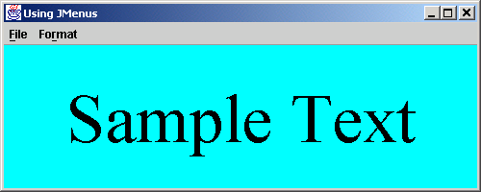
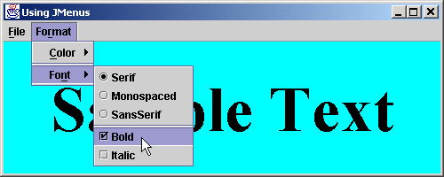
MenuTest.java
Program Output

Slide 44
13.9 Using JPopupMenus
Context-sensitive popup menus
  JPopupMenu
  Menu generated depending on which component is accessed

Slide 45
PopupTest.java
Line 29
1 // Fig. 13.11: PopupTest.java
2 // Demonstrating JPopupMenus
3
4 // Java core packages
5 import java.awt.*;
6 import java.awt.event.*;
7
8 // Java extension packages
9 import javax.swing.*;
10
11 public class PopupTest extends JFrame {
12
13 private JRadioButtonMenuItem items[];
14 private Color colorValues[] =
15 { Color.blue, Color.yellow, Color.red };
16
17 private JPopupMenu popupMenu;
18
19 // set up GUI
20 public PopupTest()
21 {
22 super( "Using JPopupMenus" );
23
24 ItemHandler handler = new ItemHandler();
25 String colors[] = { "Blue", "Yellow", "Red" };
26
27 // set up popup menu and its items
28 ButtonGroup colorGroup = new ButtonGroup();
29 popupMenu = new JPopupMenu();
30 items = new JRadioButtonMenuItem[ 3 ];
31
Instantiate JPopupMenu object

Slide 46
PopupTest.java
Lines 34-42
Lines 56 and 62
32 // construct each menu item and add to popup menu; also
33 // enable event handling for each menu item
34 for ( int count = 0; count < items.length; count++ ) {
35 items[ count ] =
36 new JRadioButtonMenuItem( colors[ count ] );
37
38 popupMenu.add( items[ count ] );
39 colorGroup.add( items[ count ] );
40
41 items[ count ].addActionListener( handler );
42 }
43
44 getContentPane().setBackground( Color.white );
45
46 // define a MouseListener for the window that displays
47 // a JPopupMenu when the popup trigger event occurs
48 addMouseListener(
49
50 // anonymous inner class to handle mouse events
51 new MouseAdapter() {
52
53 // handle mouse press event
54 public void mousePressed( MouseEvent event )
55 {
56 checkForTriggerEvent( event );
57 }
58
59 // handle mouse release event
60 public void mouseReleased( MouseEvent event )
61 {
62 checkForTriggerEvent( event );
63 }
64
Create JRadioButtonMenuItem objects to add to JPopupMenu
Determine whether popup-trigger event occurred when user presses or releases mouse button

Slide 47
PopupTest.java
Lines 68-70
Line 94
65 // determine whether event should trigger popup menu
66 private void checkForTriggerEvent( MouseEvent event )
67 {
68 if ( event.isPopupTrigger() )
69 popupMenu.show( event.getComponent(),
70 event.getX(), event.getY() );
71 }
72
73 } // end anonymous inner clas
74
75 ); // end call to addMouseListener
76
77 setSize( 300, 200 );
78 setVisible( true );
79 }
80
81 // execute application
82 public static void main( String args[] )
83 {
84 PopupTest application = new PopupTest();
85
86 application.setDefaultCloseOperation(
87 JFrame.EXIT_ON_CLOSE );
88 }
89
90 // private inner class to handle menu item events
91 private class ItemHandler implements ActionListener {
92
93 // process menu item selections
94 public void actionPerformed( ActionEvent event )
95 {
Show JPopupMenu if popup-trigger occurred
Invoked when user selects JRadioButtonMenuItem

Slide 48
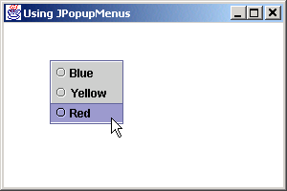
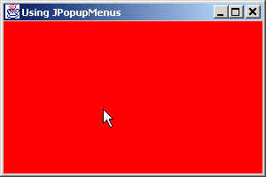
PopupTest.java
Lines 97-103
Program Output
96 // determine which menu item was selected
97 for ( int i = 0; i < items.length; i++ )
98 if ( event.getSource() == items[ i ] ) {
99 getContentPane().setBackground(
100 colorValues[ i ] );
101 repaint();
102 return;
103 }
104 }
105
106 } // end private inner class ItemHandler
107
108 } // end class PopupTest
Determine which JRadioButtonMenuItem was selected, then set window background color

Slide 49
13.10 Pluggable Look-and-Feel
Pluggable look-and-feel
  Change look-and-feel dynamically
    e.g., Microsoft Windows look-and-feel to Motif look-and-feel
  Flexible

Slide 50
LookAndFeelDemo.java
Line 14
1 // Fig. 13.12: LookAndFeelDemo.java
2 // Changing the look and feel.
3
4 // Java core packages
5 import java.awt.*;
6 import java.awt.event.*;
7
8 // Java extension packages
9 import javax.swing.*;
10
11 public class LookAndFeelDemo extends JFrame {
12
13 private String strings[] = { "Metal", "Motif", "Windows" };
14 private UIManager.LookAndFeelInfo looks[];
15 private JRadioButton radio[];
16 private ButtonGroup group;
17 private JButton button;
18 private JLabel label;
19 private JComboBox comboBox;
20
21 // set up GUI
22 public LookAndFeelDemo()
23 {
24 super( "Look and Feel Demo" );
25
26 Container container = getContentPane();
27
28 // set up panel for NORTH of BorderLayout
29 JPanel northPanel = new JPanel();
30 northPanel.setLayout( new GridLayout( 3, 1, 0, 5 ) );
31
32 // set up label for NORTH panel
33 label = new JLabel( "This is a Metal look-and-feel",
34 SwingConstants.CENTER );
35 northPanel.add( label );
Hold installed look-and-feel information

Slide 51
LookAndFeelDemo.java
36
37 // set up button for NORTH panel
38 button = new JButton( "JButton" );
39 northPanel.add( button );
40
41 // set up combo box for NORTH panel
42 comboBox = new JComboBox( strings );
43 northPanel.add( comboBox );
44
45 // attach NORTH panel to content pane
46 container.add( northPanel, BorderLayout.NORTH );
47
48 // create array for radio buttons
49 radio = new JRadioButton[ strings.length ];
50
51 // set up panel for SOUTH of BorderLayout
52 JPanel southPanel = new JPanel();
53 southPanel.setLayout(
54 new GridLayout( 1, radio.length ) );
55
56 // set up radio buttons for SOUTH panel
57 group = new ButtonGroup();
58 ItemHandler handler = new ItemHandler();
59
60 for ( int count = 0; count < radio.length; count++ ) {
61 radio[ count ] = new JRadioButton( strings[ count ] );
62 radio[ count ].addItemListener( handler );
63 group.add( radio[ count ] );
64 southPanel.add( radio[ count ] );
65 }
66
67 // attach SOUTH panel to content pane
68 container.add( southPanel, BorderLayout.SOUTH );
69

Slide 52
LookAndFeelDemo.java
Lines 84-86
70 // get installed look-and-feel information
71 looks = UIManager.getInstalledLookAndFeels();
72
73 setSize( 300, 200 );
74 setVisible( true );
75
76 radio[ 0 ].setSelected( true );
77 }
78
79 // use UIManager to change look-and-feel of GUI
80 private void changeTheLookAndFeel( int value )
81 {
82 // change look and feel
83 try {
84 UIManager.setLookAndFeel(
85 looks[ value ].getClassName() );
86 SwingUtilities.updateComponentTreeUI( this );
87 }
88
89 // process problems changing look and feel
90 catch ( Exception exception ) {
91 exception.printStackTrace();
92 }
93 }
94
95 // execute application
96 public static void main( String args[] )
97 {
98 LookAndFeelDemo application = new LookAndFeelDemo();
99
100 application.setDefaultCloseOperation(
101 JFrame.EXIT_ON_CLOSE );
102 }
103
Change look-and-feel

Slide 53
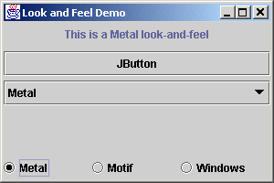
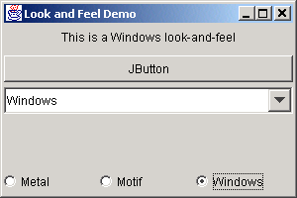
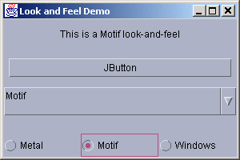
LookAndFeelDemo.java
104 // private inner class to handle radio button events
105 private class ItemHandler implements ItemListener {
106
107 // process user's look-and-feel selection
108 public void itemStateChanged( ItemEvent event )
109 {
110 for ( int count = 0; count < radio.length; count++ )
111
112 if ( radio[ count ].isSelected() ) {
113 label.setText( "This is a " +
114 strings[ count ] + " look-and-feel" );
115 comboBox.setSelectedIndex( count );
116
117 changeTheLookAndFeel( count );
118 }
119 }
120
121 } // end private inner class ItemHandler
122
123 } // end class LookAndFeelDemo

Slide 54
13.11 Using JDesktopPane and JInternalFrame
Multiple document interface
  Main (parent) window
  Child windows
  Switch freely among documents

Slide 55
DesktopTest.java
Line 12
Line 34
1 // Fig. 13.13: DesktopTest.java
2 // Demonstrating JDesktopPane.
3
4 // Java core packages
5 import java.awt.*;
6 import java.awt.event.*;
7
8 // Java extension packages
9 import javax.swing.*;
10
11 public class DesktopTest extends JFrame {
12 private JDesktopPane theDesktop;
13
14 // set up GUI
15 public DesktopTest()
16 {
17 super( "Using a JDesktopPane" );
18
19 // create menu bar, menu and menu item
20 JMenuBar bar = new JMenuBar();
21 JMenu addMenu = new JMenu( "Add" );
22 JMenuItem newFrame = new JMenuItem( "Internal Frame" );
23
24 addMenu.add( newFrame );
25 bar.add( addMenu );
26
27 setJMenuBar( bar );
28
29 // set up desktop
30 theDesktop = new JDesktopPane();
31 getContentPane().add( theDesktop );
32
33 // set up listener for newFrame menu item
34 newFrame.addActionListener(
35
Manages JInternalFrame child windows displayed in JDesktopPane
Handle event when user selects JMenuItem

Slide 56
DesktopTest.java
Line 40
Lines 43-44
Lines 48-49
Line 52
36 // anonymous inner class to handle menu item event
37 new ActionListener() {
38
39 // display new internal window
40 public void actionPerformed( ActionEvent event ) {
41
42 // create internal frame
43 JInternalFrame frame = new JInternalFrame(
44 "Internal Frame", true, true, true, true );
45
46 // attach panel to internal frame content pane
47 Container container = frame.getContentPane();
48 MyJPanel panel = new MyJPanel();
49 container.add( panel, BorderLayout.CENTER );
50
51 // set size internal frame to size of its contents
52 frame.pack();
53
54 // attach internal frame to desktop and show it
55 theDesktop.add( frame );
56 frame.setVisible( true );
57 }
58
59 } // end anonymous inner class
60
61 ); // end call to addActionListener
62
63 setSize( 600, 440 );
64 setVisible( true );
65
66 } // end constructor
67
Invoked when user selects JMenuItem
Create JInternalFrame
JPanels can be added to JInternalFrames
Use preferred size for window

Slide 57
DesktopTest.java
68 // execute application
69 public static void main( String args[] )
70 {
71 DesktopTest application = new DesktopTest();
72
73 application.setDefaultCloseOperation(
74 JFrame.EXIT_ON_CLOSE );
75 }
76
77 } // end class DesktopTest
78
79 // class to display an ImageIcon on a panel
80 class MyJPanel extends JPanel {
81 private ImageIcon imageIcon;
82
83 // load image
84 public MyJPanel()
85 {
86 imageIcon = new ImageIcon( "jhtp4.png" );
87 }
88
89 // display imageIcon on panel
90 public void paintComponent( Graphics g )
91 {
92 // call superclass paintComponent method
93 super.paintComponent( g );
94
95 // display icon
96 imageIcon.paintIcon( this, g, 0, 0 );
97 }
98

Slide 58
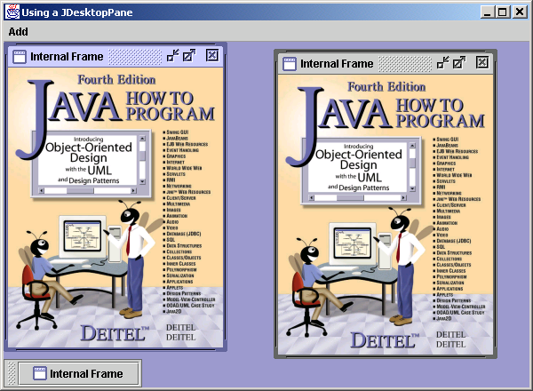
DesktopTest.java
Program Output
99 // return image dimensions
100 public Dimension getPreferredSize()
101 {
102 return new Dimension( imageIcon.getIconWidth(),
103 imageIcon.getIconHeight() );
104 }
105
106 } // end class MyJPanel
Internal Frames
Minimize
Maximize
Close
Minimized internal frame
Position the mouse over any corner of a child
window to resize the window (if resizing is allowed).

Slide 59
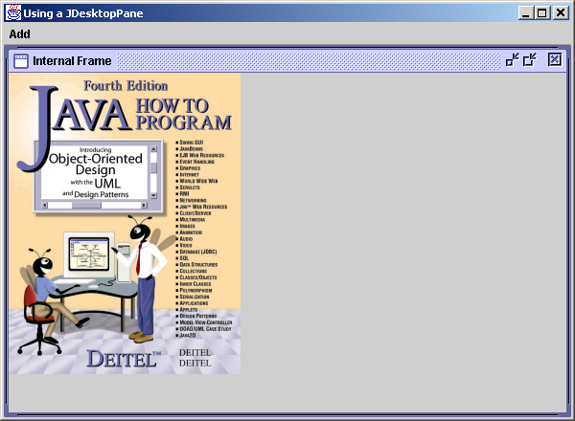
DesktopTest.java
Program Output
Maximized Internal Frame

Slide 60
13.12 Layout Managers
Layout Managers
  BoxLayout
  CardLayout
  GridBagLayout

Slide 61
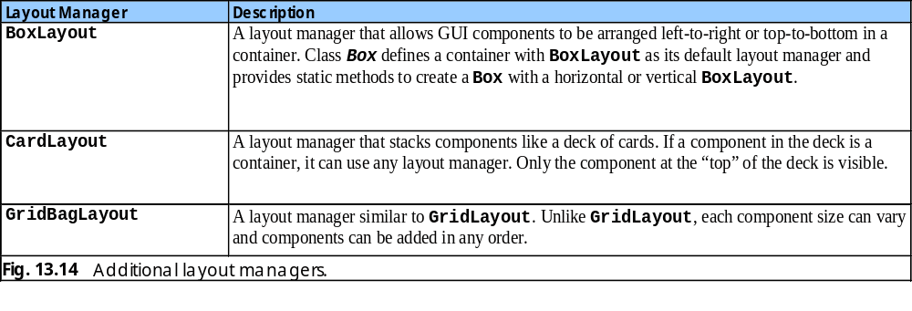
Fig. 13.14 Additional Layout Managers

Slide 75
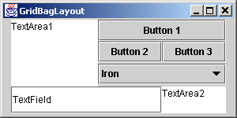
Fig. 13.19 GridBagLayout with the weights set to zero.

Slide 76
GridBagDemo.java
Lines 22-23
Line 26
1 // Fig. 13.20: GridBagDemo.java
2 // Demonstrating GridBagLayout.
3
4 // Java core packages
5 import java.awt.*;
6 import java.awt.event.*;
7
8 // Java extension packages
9 import javax.swing.*;
10
11 public class GridBagDemo extends JFrame {
12 private Container container;
13 private GridBagLayout layout;
14 private GridBagConstraints constraints;
15
16 // set up GUI
17 public GridBagDemo()
18 {
19 super( "GridBagLayout" );
20
21 container = getContentPane();
22 layout = new GridBagLayout();
23 container.setLayout( layout );
24
25 // instantiate gridbag constraints
26 constraints = new GridBagConstraints();
27
28 // create GUI components
29 JTextArea textArea1 = new JTextArea( "TextArea1", 5, 10 );
30 JTextArea textArea2 = new JTextArea( "TextArea2", 2, 2 );
31
32 String names[] = { "Iron", "Steel", "Brass" };
33 JComboBox comboBox = new JComboBox( names );
34
Set GridBagLayout as layout manager
Used to determine component location and size in grid

Slide 77
GridBagDemo.java
Line 43
Line 44
Line 48
Line 49
Lines 57-60
35 JTextField textField = new JTextField( "TextField" );
36 JButton button1 = new JButton( "Button 1" );
37 JButton button2 = new JButton( "Button 2" );
38 JButton button3 = new JButton( "Button 3" );
39
40 // textArea1
41 // weightx and weighty are both 0: the default
42 // anchor for all components is CENTER: the default
43 constraints.fill = GridBagConstraints.BOTH;
44 addComponent( textArea1, 0, 0, 1, 3 );
45
46 // button1
47 // weightx and weighty are both 0: the default
48 constraints.fill = GridBagConstraints.HORIZONTAL;
49 addComponent( button1, 0, 1, 2, 1 );
50
51 // comboBox
52 // weightx and weighty are both 0: the default
53 // fill is HORIZONTAL
54 addComponent( comboBox, 2, 1, 2, 1 );
55
56 // button2
57 constraints.weightx = 1000; // can grow wider
58 constraints.weighty = 1; // can grow taller
59 constraints.fill = GridBagConstraints.BOTH;
60 addComponent( button2, 1, 1, 1, 1 );
61
62 // button3
63 // fill is BOTH
64 constraints.weightx = 0;
65 constraints.weighty = 0;
66 addComponent( button3, 1, 2, 1, 1 );
67
If user resizes Container, first JTextArea is filled entire allocated area in grid
First JTextArea spans one row and three columns
If user resizes Container, first JButton fills horizontally in grid
First JButton spans two rows and one column
If user resizes Container, second JButton fills extra space

Slide 78
GridBagDemo.java
68 // textField
69 // weightx and weighty are both 0, fill is BOTH
70 addComponent( textField, 3, 0, 2, 1 );
71
72 // textArea2
73 // weightx and weighty are both 0, fill is BOTH
74 addComponent( textArea2, 3, 2, 1, 1 );
75
76 setSize( 300, 150 );
77 setVisible( true );
78 }
79
80 // method to set constraints on
81 private void addComponent( Component component,
82 int row, int column, int width, int height )
83 {
84 // set gridx and gridy
85 constraints.gridx = column;
86 constraints.gridy = row;
87
88 // set gridwidth and gridheight
89 constraints.gridwidth = width;
90 constraints.gridheight = height;
91
92 // set constraints and add component
93 layout.setConstraints( component, constraints );
94 container.add( component );
95 }
96

Slide 79
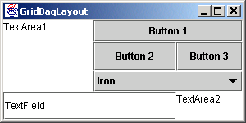
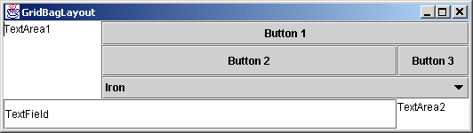
GridBagDemo.java
Program Output
97 // execute application
98 public static void main( String args[] )
99 {
100 GridBagDemo application = new GridBagDemo();
101
102 application.setDefaultCloseOperation(
103 JFrame.EXIT_ON_CLOSE );
104 }
105
106 } // end class GridBagDemo

Slide 80
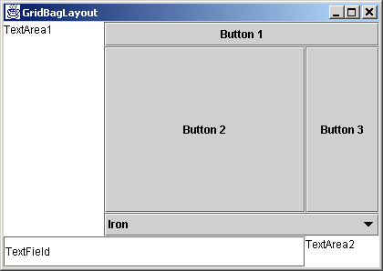
GridBagDemo.java
Program Output

Slide 81
13.16 GridBagConstraints Constants RELATIVE and REMAINDER
Constants RELATIVE and REMAINDER
  Used in place of variables gridx and gridy
  RELATIVE
    Specifies next-to-last component placement in row or column
      Component should be placed next to one previously added
  REMAINDER
    Specifies component as last component in row or column

Slide 82
GridBagDemo2.java
Lines 22-23
Line 26
1 // Fig. 13.21: GridBagDemo2.java
2 // Demonstrating GridBagLayout constants.
3
4 // Java core packages
5 import java.awt.*;
6 import java.awt.event.*;
7
8 // Java extension packages
9 import javax.swing.*;
10
11 public class GridBagDemo2 extends JFrame {
12 private GridBagLayout layout;
13 private GridBagConstraints constraints;
14 private Container container;
15
16 // set up GUI
17 public GridBagDemo2()
18 {
19 super( "GridBagLayout" );
20
21 container = getContentPane();
22 layout = new GridBagLayout();
23 container.setLayout( layout );
24
25 // instantiate gridbag constraints
26 constraints = new GridBagConstraints();
27
28 // create GUI components
29 String metals[] = { "Copper", "Aluminum", "Silver" };
30 JComboBox comboBox = new JComboBox( metals );
31
32 JTextField textField = new JTextField( "TextField" );
33
34 String fonts[] = { "Serif", "Monospaced" };
35 JList list = new JList( fonts );
Set GridBagLayout as layout manager
Used to determine component location and size in grid

Slide 83
GridBagDemo2.java
Line 49
Lines 53-54
Lines 57-58
Lines 61-62
Lines 65-67
36
37 String names[] =
38 { "zero", "one", "two", "three", "four" };
39 JButton buttons[] = new JButton[ names.length ];
40
41 for ( int count = 0; count < buttons.length; count++ )
42 buttons[ count ] = new JButton( names[ count ] );
43
44 // define GUI component constraints
45 // textField
46 constraints.weightx = 1;
47 constraints.weighty = 1;
48 constraints.fill = GridBagConstraints.BOTH;
49 constraints.gridwidth = GridBagConstraints.REMAINDER;
50 addComponent( textField );
51
52 // buttons[0] -- weightx and weighty are 1: fill is BOTH
53 constraints.gridwidth = 1;
54 addComponent( buttons[ 0 ] );
55
56 // buttons[1] -- weightx and weighty are 1: fill is BOTH
57 constraints.gridwidth = GridBagConstraints.RELATIVE;
58 addComponent( buttons[ 1 ] );
59
60 // buttons[2] -- weightx and weighty are 1: fill is BOTH
61 constraints.gridwidth = GridBagConstraints.REMAINDER;
62 addComponent( buttons[ 2 ] );
63
64 // comboBox -- weightx is 1: fill is BOTH
65 constraints.weighty = 0;
66 constraints.gridwidth = GridBagConstraints.REMAINDER;
67 addComponent( comboBox );
68
Specify textField as last (only) component in first row
Place button[0] as first component in second row
Place button[1] right next to button[0]
Place button[2] right next to button[1]
Specify comboBox as last (only) component in third row

Slide 84
GridBagDemo2.java
Lines 70-72
Lines 75-76
Lines 79-80
69 // buttons[3] -- weightx is 1: fill is BOTH
70 constraints.weighty = 1;
71 constraints.gridwidth = GridBagConstraints.REMAINDER;
72 addComponent( buttons[ 3 ] );
73
74 // buttons[4] -- weightx and weighty are 1: fill is BOTH
75 constraints.gridwidth = GridBagConstraints.RELATIVE;
76 addComponent( buttons[ 4 ] );
77
78 // list -- weightx and weighty are 1: fill is BOTH
79 constraints.gridwidth = GridBagConstraints.REMAINDER;
80 addComponent( list );
81
82 setSize( 300, 200 );
83 setVisible( true );
84
85 } // end constructor
86
87 // addComponent is programmer-defined
88 private void addComponent( Component component )
89 {
90 layout.setConstraints( component, constraints );
91 container.add( component ); // add component
92 }
93
94 // execute application
95 public static void main( String args[] )
96 {
97 GridBagDemo2 application = new GridBagDemo2();
98
99 application.setDefaultCloseOperation(
100 JFrame.EXIT_ON_CLOSE );
101 }
102
103 } // end class GridBagDemo2
Specify buttons[3] as last (only) component in fourth row
Place button[4] as first component in fifth row
Specify list as last component in fifth row

Slide 85
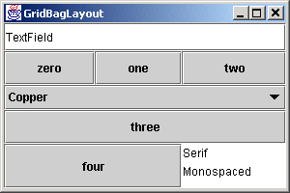
GridbagDemo2.java
Program Output

Slide 86
13.17 (Optional Case Study) Thinking About Objects: Model-View-Controller
Model-View-Controller
  Architectural pattern for building systems
  Divide system responsibilities into three parts
    Model
      Contains all program data and logic
    View
      Visual representation of model
    Controller
      Defines system behavior by sending user input to model
  Step by step
    User uses controller to change data in model
    Model then informs view of change
    View changes visual presentation to reflect change

Slide 87
13.17 Thinking About Objects (cont.)
Model-View-Controller in elevator simulation
  Example
    User presses First Floor of Second Floor Jbutton
      Controller adds Person to model
    Model notifies view of Person’s creation
    View displays Person on Floor in response to notification

Slide 88
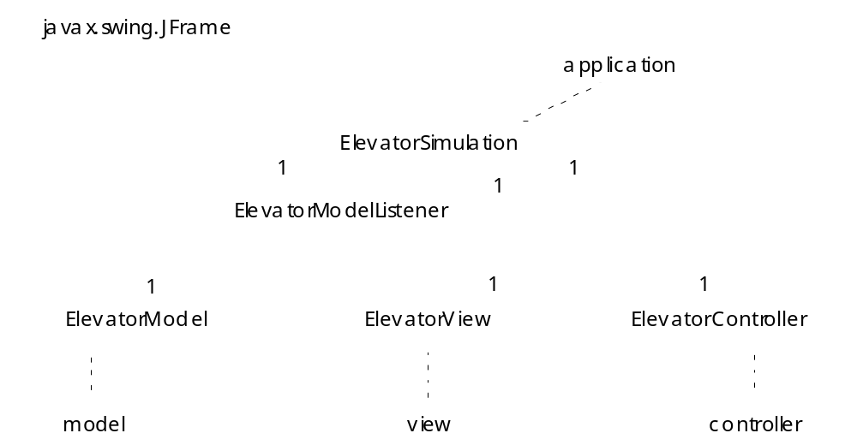
Fig. 13.22 Class diagram of the elevator simulation.

Slide 89
13.17 Thinking About Objects (cont.)
Component diagram (UML)
  Models “pieces” (components) used by system
    e.g., .class file, .java files, images, packages, etc.
  Notation
    Components are represented as “plugs”
    Packages are represented as “folders”
    Dotted arrows indicate dependencies among components
      Changing one component requires changing another

Slide 90
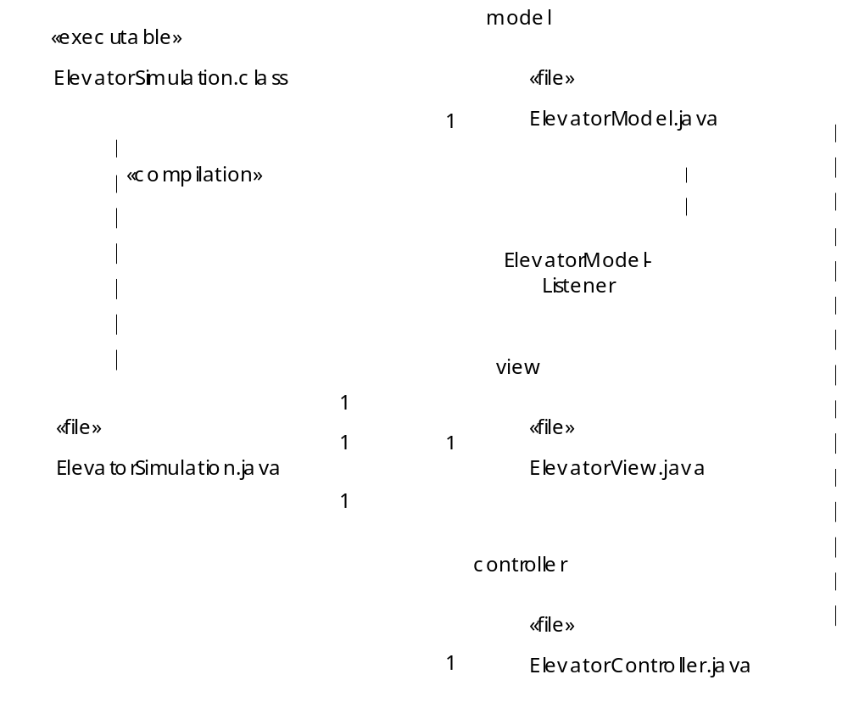
Fir. 13.23 Component diagram for elevator simulation

Slide 91
ElevatorSimulation.java
Lines 12-13
Lines 19-21
Line 34
1 // ElevatorSimulation.java
2 // Application with Elevator Model, View, and Controller (MVC)
3 package com.deitel.jhtp4.elevator;
4
5 // Java core packages
6 import java.awt.*;
7
8 // Java extension packages
9 import javax.swing.*;
10
11 // Deitel packages
12 import com.deitel.jhtp4.elevator.model.*;
13 import com.deitel.jhtp4.elevator.view.*;
14 import com.deitel.jhtp4.elevator.controller.*;
15
16 public class ElevatorSimulation extends JFrame {
17
18 // model, view and controller
19 private ElevatorModel model;
20 private ElevatorView view;
21 private ElevatorController controller;
22
23 // constructor instantiates model, view, and controller
24 public ElevatorSimulation()
25 {
26 super( "Deitel Elevator Simulation" );
27
28 // instantiate model, view and controller
29 model = new ElevatorModel();
30 view = new ElevatorView();
31 controller = new ElevatorController( model );
32
33 // register View for Model events
34 model.setElevatorModelListener( view );
35
Import packages model, view and controller
ElevatorSimulation aggregates one instance each of classes ElevatorModel, ElevatorView and ElevatorController
Register ElevatorModel as listener for ElevatorView

Slide 92
ElevatorSimulation.java
Lines 37-38
36 // add view and controller to ElevatorSimulation
37 getContentPane().add( view, BorderLayout.CENTER );
38 getContentPane().add( controller, BorderLayout.SOUTH );
39
40 } // end ElevatorSimulation constructor
41
42 // main method starts program
43 public static void main( String args[] )
44 {
45 // instantiate ElevatorSimulation
46 ElevatorSimulation simulation = new ElevatorSimulation();
47 simulation.setDefaultCloseOperation( EXIT_ON_CLOSE );
48 simulation.pack();
49 simulation.setVisible( true );
50 }
51 }
Add ElevatorView and ElevatorController to ElevatorSimulation

Slide 93
13.18 (Optional) Discovering Design Patterns: Design Patterns Used in Packages java.awt and javax.swing
Continue design-patterns discussion
  Design patterns associated with Java GUI components
    GUI components take advantage of design patterns

Slide 94
13.18.1 Creational Design Patterns
Factory Method design pattern
  Suppose we design system that opens image from file
    Several image formats exist (e.g., GIF, JPEG, etc.)
      Each image format has different structure
    Method createImage of class Component creates Image
    Two Image objects (one for GIF image, one for JPEG image)
    Method createImage uses parameter to determine proper Image subclass from which to instantiate Image object
      createImage( "image.gif" );
      Returns Image object with GIF data
      createImage( "image.jpg" );
      Returns Image object with JPEG data
    Method createImage is called a factory method
      Determines subclass to instantiate object at run time

Slide 95
13.18.2 Structural Design Patterns
Adapter design pattern
  Used with objects with incompatible interfaces
    Allows these objects to collaborate with each other
    Object’s interface adapts to another object’s interface
  Similar to adapter for plug on electrical device
    European electrical sockets differ from those in United States
    American plug will not work with European socket
    Use adapter for plug
  Class MouseAdapter
    Objects that generate MouseEvents adapts to objects that handle MouseEvents

Slide 96
13.18.2 Structural Design Patterns (cont.)
Bridge design pattern
  Design class Button for Windows and Macintosh systems
    Class contains button information (e.g., String label)
    Subclasses Win32Button and MacButton
      Contain look-and-feel information
    Problem with this approach
      Creating class ImageButton (subclass of Button)
        Requires creating Win32ImageButton and MacImageButton
    Solution:
      Separate abstraction (i.e., Button) from implementation (i.e., Win32Button and MacButton)
      Button contains reference (bridge) to ButtonPeer
        Handles platform-specific implementations

Slide 97
13.18.2 Structural Design Patterns (cont.)
Composite design pattern
  Organize components into hierarchical structures
    Each node represents component
    All nodes implement same interface
      Polymorphism ensures clients traverse all nodes uniformly
  Used by Swing components
    JPanel is JContainer subclass
    JPanel object can contain GUI component
      JPanel remains unaware of component’s specific type

Slide 98
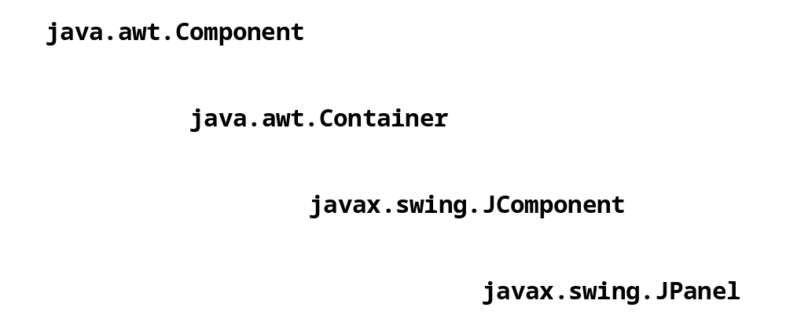
Fig. 13.25 Inheritance hierarchy for class JPanel.

Slide 99
13.18.3 Behavioral Design Patterns
Chain-of-Responsibility design pattern
  Determine object that handles message at run time
  Three-line office-phone system
    First line handles call
    If first line is busy, second line handles call
    If second line is busy, third line handles call
  Message sent through “chain”
    Each object in chain decides whether to handle message
      If unable to handle message, that object sends message to next object in chain
  Method processEvent of class Button
    Handles AWTEvent or sends to next object

Slide 100
13.18.3 Behavioral Design Patterns (cont.)
Command design pattern
  Applications provide several ways to perform same task
    Edit menu with menu items for cutting and copying text
    Toolbar and popup menus may offer same feature
  Encapsulate functionality (command) in reusable object
    e.g., “cut text” functionality
    Functionality can then be added to menus, toolbars, etc.
    Developers code functionality only once

Slide 101
13.18.3 Behavioral Design Patterns (cont.)
Observer design pattern
  Design program for viewing bank-account information
    Class BankStatementData store bank-statement data
    Class TextDisplay displays data in text format
    Class BarGraphDisplay displays data in bar-graph format
    Class PieChartDisplay displays data in pie-chart format
    BankStatementData (subject) notifies Display classes (observers) to display data when it changes
  Subject notifies observers when subject changes state
    Observers act in response to notification
    Promotes loose coupling
  Used by
    class java.util.Observable
    class java.util.Observer

Slide 102

Fig. 13.26 Basis for the Observer design pattern.

Slide 103
13.18.3 Behavioral Design Patterns (cont.)
Strategy design pattern
  Encapsulates algorithm
  LayoutManagers are strategy objects
    Classes FlowLayout, BorderLayout, GridLayout, etc.
      Implement interface LayoutManager
    Each class uses method addLayoutComponent
      Each method implementation uses different algorithm
        FlowLayout adds components left-to-right
        BorderLayout adds components in five regions
        GridLayout adds components in specified grid
    Class Container has LayoutManager reference
      Use method setLayout
        Select different layout manager at run time

Slide 104
13.18.3 Behavioral Design Patterns (cont.)
Template Method design pattern
  Objects share single algorithm defined in superclass
  Consider Fig.13.26
    Display objects use same algorithm to acquire and display data
      Get statements from BankStatementData
      Parse statements
      Display statements
    Create superclass BankStatementDisplay
      Provides methods that comprise algorithm
      Subclasses override “display” method, because each subclass displays data differently

